Slide 1



ecx.io Frontend Bootcamp — DOM Intro, Events 01.07.2021.

Slide 2

Agenda
Intro to DOM
Window and document
Events

Slide 3

Intro to DOM

Slide 4
DOM
The Document Object Model (DOM) is a programming interface for HTML and XML documents. It represents the page so that programs can change the document structure, style, and content.

Slide 5
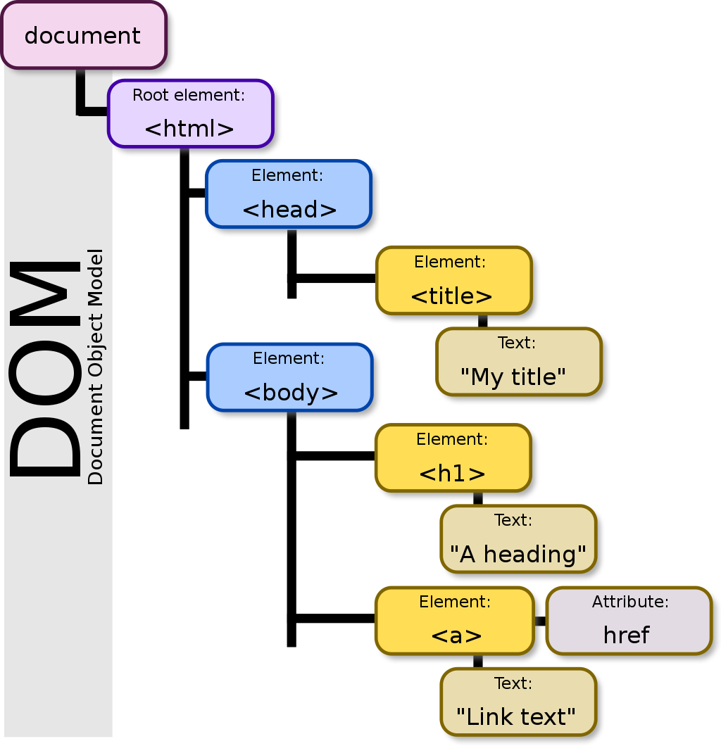
The DOM represents a document with a logical tree. Each branch of the tree ends in a node, and each node contains objects. DOM methods allow programmatic access to the tree. With them, you can change the document's structure, style, or content.
Notes:
The W3C DOM and WHATWG DOM standards are implemented in most modern browsers. Many browsers extend the standard, so care must be exercised when using them on the web where documents may be accessed by various browsers with different DOMs.

Slide 6
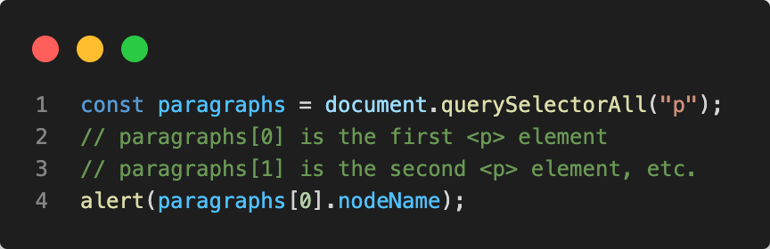
The standard DOM specifies that the querySelectorAll method in the code must return a list of all the <p> elements in the document

Slide 7
DOM and JavaScript The DOM is not a programming language, but without it, the JavaScript language wouldn't have any model or notion of web pages, HTML documents, XML documents, and their component parts (e.g. elements). The DOM was designed to be independent of any particular programming language, making the structural representation of the document available from a single, consistent API. Implementations of the DOM can be built for any language.
Notes:
The short example above is written in JavaScript, but it uses the DOM to access the document and its elements.

Slide 8
Window and document

Slide 9
Document
The Document interface represents any web page loaded in the browser and serves as an entry point into the web page's content, which is the DOM tree. The DOM tree includes elements such as <body> and <table>, among many others. It provides functionality globally to the document, like how to obtain the page's URL and create new elements in the document.

Slide 10
Window
The Window interface represents a window containing a DOM document; the document property points to the DOM document loaded in that window. A window for a given document can be obtained using the document.defaultView property.

Slide 11
Accessing the DOM
When you create a script–whether it's inline in a <script> element or included in the web page by means of a script loading instruction–you can immediately begin using the API for the document or window elements to manipulate the document itself or to get at the children of that document, which are the various elements in the web page.

Slide 12
Demo
Notes:
Live demo: <body onload="window.alert('Welcome to my home page!');">
<body onload="window.prompt('What\'s your name?');">
<html> <head> <script> // run this function when the document is loaded window.onload = function() { // create a couple of elements in an otherwise empty HTML page const heading = document.createElement("h1"); const heading_text = document.createTextNode("Big Head!"); heading.appendChild(heading_text); document.body.appendChild(heading); } </script> </head> <body> </body> </html>

Slide 13
Fundamental data types
Data type (Interface) | Description
Document | When a member returns an object of type document, this object is the root document object itself.
Node | Every object located within a document is a node of some kind. In an HTML document, an object can be an element node but also a text node or attribute node.
Element | The element type is based on node. It refers to an element or a node of type element returned by a member of the DOM API. Rather than saying, for example, that the document.createElement() method returns an object reference to a node, we just say that this method returns the element that has just been created in the DOM. element objects implement the DOM Element interface and also the more basic Node interface, both of which are included together in this reference. In an HTML document, elements are further enhanced by the HTML DOM API's HTMLElement interface as well as other interfaces describing capabilities of specific kinds of elements.
NodeList | A nodeList is an array of elements, like the kind that is returned by the method document.querySelectorAll(). Items in a nodeList are accessed by index in either of two ways: list.item(1) list[1] These two are equivalent. In the first, item() is the single method on the nodeList object. The latter uses the typical array syntax to fetch the second item in the list.
Attribute | When an attribute is returned by a member (e.g., by the createAttribute() method), it is an object reference that exposes a special (albeit small) interface for attributes. Attributes are nodes in the DOM just like elements are, though you may rarely use them as such.

Slide 14
DOM interfaces
Many objects borrow from several different interfaces. The table object, for example, implements a specialized HTMLTableElement interface, which includes such methods as createCaption and insertRow. But since it's also an HTML element, table implements the Element interface.
The window object represents something like the browser, and the document object is the root of the document itself. Element inherits from the generic Node interface, and together these two interfaces provide many of the methods and properties you use on individual elements.

Slide 15
Brief list of common APIs in web and XML page scripting using the DOM
document.querySelector(selector)
document.querySelectorAll(name)
document.createElement(name)
parentNode.appendChild(node)
element.innerHTML
element.style.left
element.setAttribute()
element.getAttribute()
element.addEventListener()
window.content
GlobalEventHandlers/onload
window.scrollTo()

Slide 16
Exercise
Go to https://www.ecx.io/en/ 1. Query all h2 elements<br/> 1.1. Get second item from the node list<br/> 1.2. Change its font size to 80px
2. Get window inner height<br/> 2.1. What's the difference between inner and outer height?
3. Get all elements with the class name 'container'<br/> 3.1. Get first element from the list and list all of it's classes

Slide 17
Events

Slide 18
Events
Events are actions or occurrences that happen in the system you are programming, which the system tells you about so you can respond to them in some way if desired.
Events are fired inside the browser window, and tend to be attached to a specific item that resides in it — this might be a single element, set of elements, the HTML document loaded in the current tab, or the entire browser window.

Slide 19
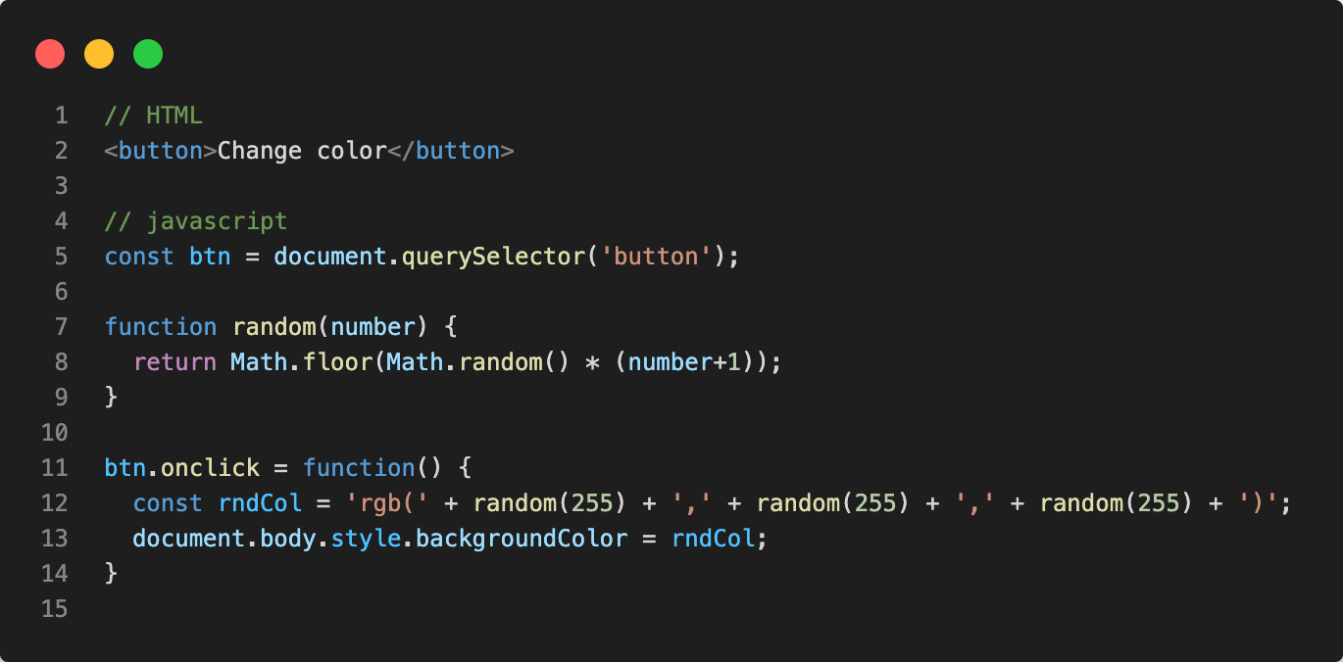
Events
Each available event has an event handler, which is a block of code that runs when the event fires. When such a block of code is defined to run in response to an event, we say we are registering an event handler.
Notes:
We store a reference to the button inside a constant called btn, using the Document.querySelector() function. We also define a function that returns a random number. The third part of the code is the event handler. The btn constant points to a <button> element, and this type of object has a number of events that can fire on it, and therefore, event handlers available. We are listening for the click event firing, by setting the onclick event handler property to equal an anonymous function containing code that generates a random RGB color and sets the <body> background-color equal to it.

Slide 20
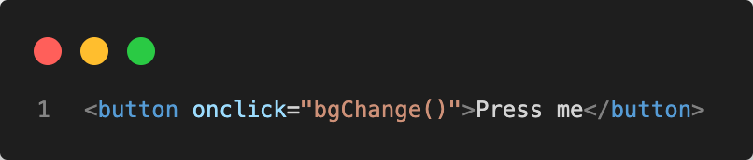
Inline event handlers — don't use these
You can find HTML attribute equivalents for many of the event handler properties; however, you shouldn't use these — they are considered bad practice. It might seem easy to use an event handler attribute if you are doing something really quick, but they quickly become unmanageable and inefficient.
Notes:
For a start, it is not a good idea to mix up your HTML and your JavaScript, as it becomes hard to parse — keeping your JavaScript separate is best practice; if it is in a separate file you can apply it to multiple HTML documents.

Slide 21
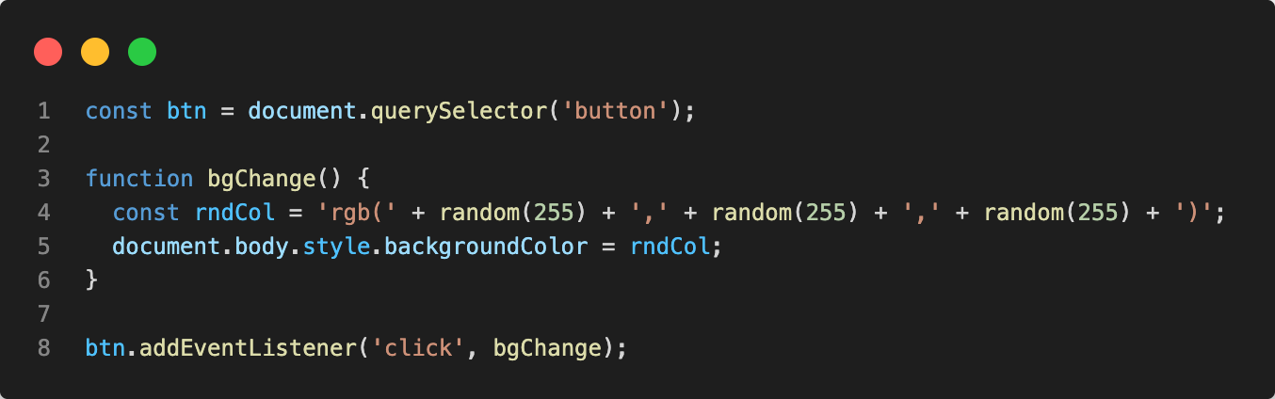
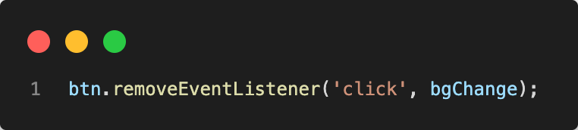
Adding and removing event handlers
The modern mechanism for adding event handlers is the addEventListener() method. Using it, we could rewrite our random color example.
This mechanism has some advantages over the older mechanisms discussed. First, there is a counterpart function, removeEventListener(), which removes a previously added event handler.
Notes:
Inside the addEventListener() function, we specify two parameters: the name of the event we want to register this handler for, and the code that comprises the handler function we want to run in response to it.

Slide 22
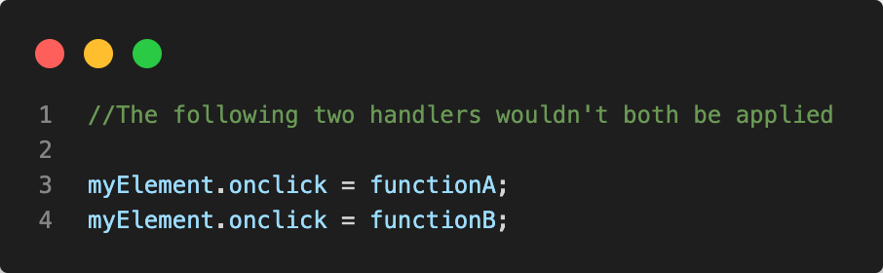
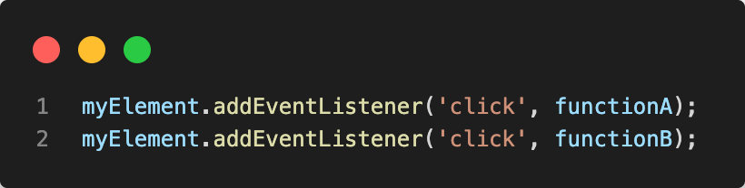
Adding and removing event handlers
The second advantage that addEventListener() has over the older mechanisms is that it allows you to register multiple handlers for the same listener.
Notes:
First example: The second line overwrites the value of onclick set by the first line
Second example: Both functions would now run when the element is selected.

Slide 23
Exercise
In the provided events.html write javascript code to count button clicks.
In the provided events2.html write javascript code that will output the input value in the console as the user types.

Slide 24
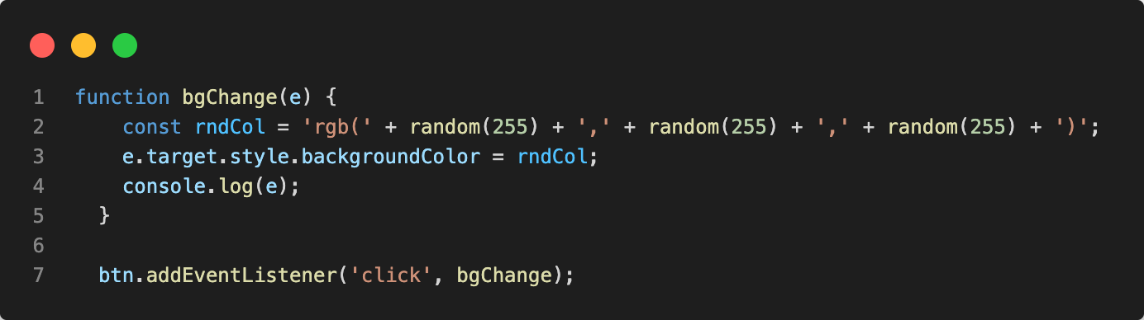
Event objects
Inside an event handler function you can specify parameter name such as event, evt or e (you can use any name you like for the event object). This is called the event object, and it is automatically passed to event handlers to provide extra features and information.
Notes:
The target property of the event object is always a reference to the element the event occurred upon.

Slide 25
Preventing default behavior
The Event interface's preventDefault() method tells the user agent that if the event does not get explicitly handled, its default action should not be taken as it normally would be.
Notes:
Sometimes, you'll come across a situation where you want to prevent an event from doing what it does by default. The most common example is that of a web form, for example, a custom registration form. When you fill in the details and select the submit button, the natural behavior is for the data to be submitted to a specified page on the server for processing, and the browser to be redirected to a "success message" page of some kind (or the same page, if another is not specified.)

Slide 26
Demo
Notes:
Open prevent-default.html

Slide 27
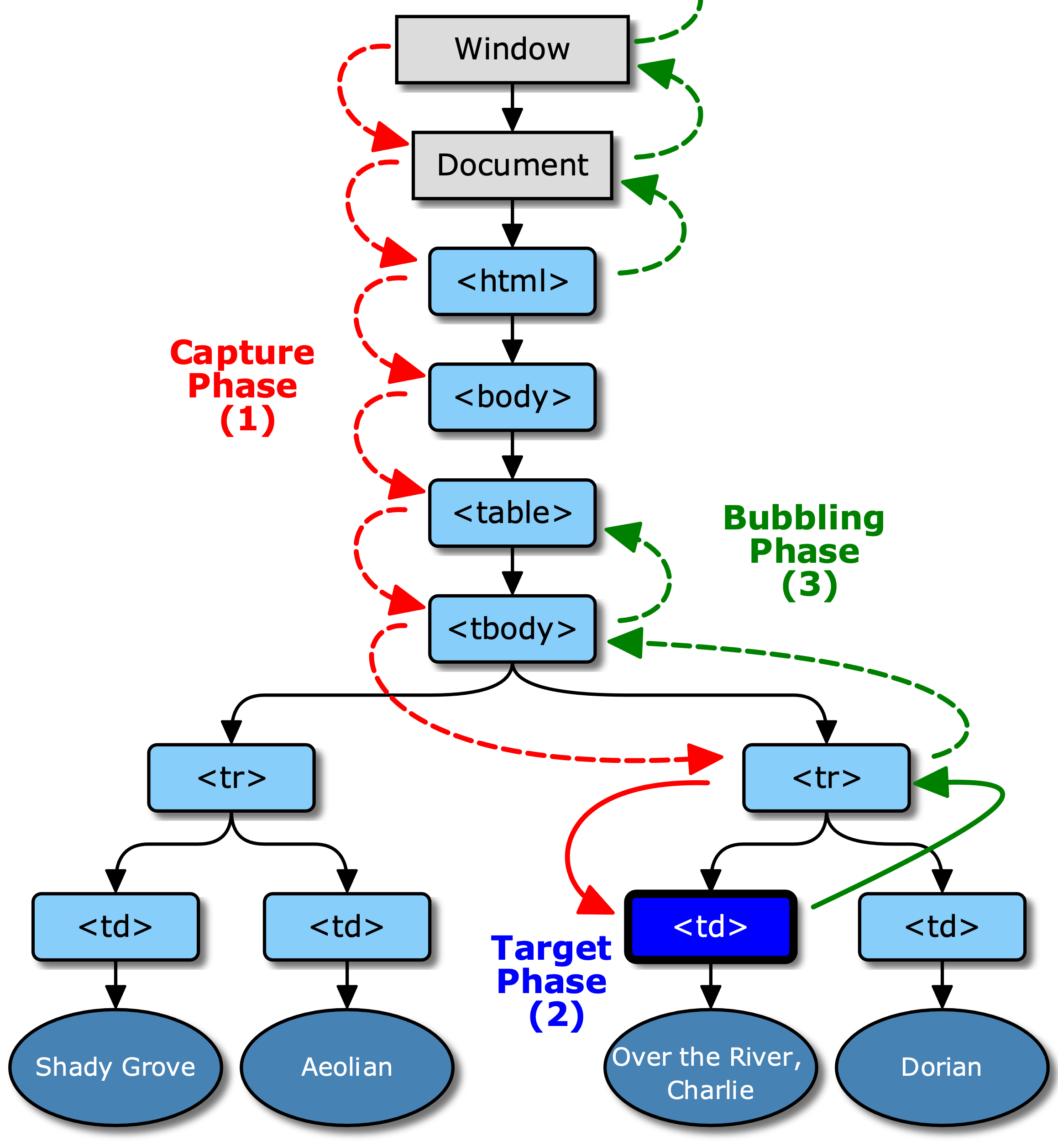
Event bubbling and capture
Event bubbling and capture are two mechanisms that describe what happens when two handlers of the same event type are activated on one element.
The standard DOM Events describes 3 phases of event propagation:
Capturing phase – the event goes down to the element.
Target phase – the event reached the target element.
Bubbling phase – the event bubbles up from the element.
Notes:
For a click on <td> the event first goes through the ancestors chain down to the element (capturing phase), then it reaches the target and triggers there (target phase), and then it goes up (bubbling phase), calling handlers on its way.

Slide 28
Bubbling
When an event happens on an element, it first runs the handlers on it, then on its parent, then all the way up on other ancestors.
The most deeply nested element that caused the event is called a target element, accessible as event.target.
event.target – is the “target” element that initiated the event, it doesn’t change through the bubbling process.
this or event.currentTarget – is the “current” element, the one that has a currently running handler on it

Slide 29
Demo
Notes:
Open bubbling.html

Slide 30
Stopping bubbling
The method to stop bubbling is event.stopPropagation()
NOTE: Don’t stop bubbling without a need!
Bubbling is convenient. Don’t stop it without a real need: obvious and architecturally well thought out.
Sometimes event.stopPropagation() creates hidden pitfalls that later may become problems.
Notes:
A bubbling event goes from the target element straight up. Normally it goes upwards till <html>, and then to document object, and some events even reach window, calling all handlers on the path.
But any handler may decide that the event has been fully processed and stop the bubbling.

Slide 31
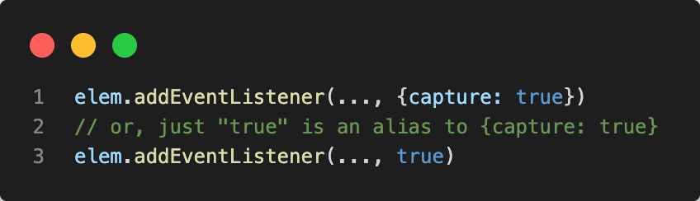
Capturing
It is rarely used in real code, but sometimes can be useful. Normally it is invisible to us.
Handlers added using on<event>- property or using HTML attributes or using two-argument addEventListener(event, handler) don’t know anything about capturing, they only run on the 2nd and 3rd phases.
To catch an event on the capturing phase, we need to set the handler capture option to true
Notes:
Example is blur.
If I’m listening for blur on a specific input, I can leave use capture as false.
someInput.addEventListener('blur', function (event) { // Do stuff... }, false);
BUT… if I wanted to listen to all blur events in the document, I would set it to true.
document.addEventListener('blur', function (event) { // Do stuff... }, true);

Slide 32
Demo
Notes:
Open capturing.html

Slide 33
Event delegation
Bubbling also allows us to take advantage of event delegation — this concept relies on the fact that if you want some code to run when you select any one of a large number of child elements, you can set the event listener on their parent and have events that happen on them bubble up to their parent rather than having to set the event listener on every child individually.

Slide 34
Demo
Notes:
Open delegation.html

Slide 35
Reference links
Javascript
https://developer.mozilla.org/en-US/docs/Web/JavaScript
JavaScript HTML DOM
https://www.w3schools.com/js/js_htmldom.asp
Handling Events
https://eloquentjavascript.net/15_event.html

Slide 36
Friday exercise – Todo app
Acceptance Criteria
There is a label with text: ”Todo” Below the label is the input field Below the input field is the Submit button
When a user submits his todo it should be added below the button.
if the input field is empty and submit button clicked show alert message “Input field can't be empty”
Each todo item has a red X on the right side and bottom line.
when the user clicks the X button show confirm dialog with text "Are you sure?”
if confirmed delete the item from the list, otherwise do nothing
Please see attached design example, feel free to design it as you want.
As a | website editor
I want to | create my list of tasks
so that | I don’t forget what I have to do

Slide 37
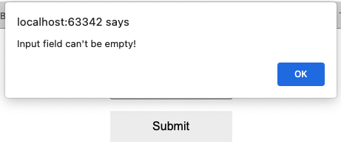
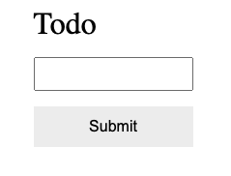
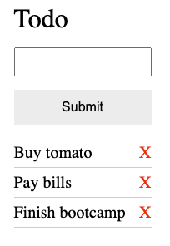
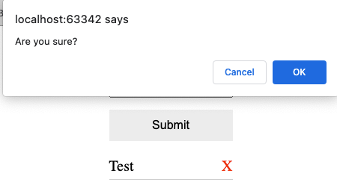
Friday exercise – Todo app

Slide 38
Thank you
© Copyright IBM Corporation 2019.
All rights reserved. The information contained in these materials is provided for informational purposes only, and is provided AS IS without warranty of any kind, express or implied. Any statement of direction represents IBM’s current intent, is subject to change or withdrawal, and represent only goals and objectives. IBM, the IBM logo, and ibm.com are trademarks of IBM Corp., registered in many jurisdictions worldwide. Other product and service names might be trademarks of IBM or other companies.
A current list of IBM trademarks is available at Copyright and trademark information.

